Slide 1
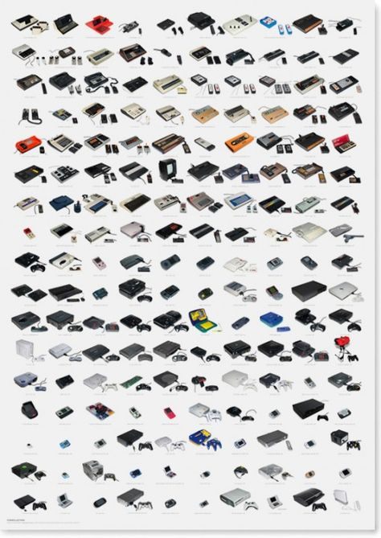
Historical Console Video Game Sales
Robert Johnson

Slide 2

Content
History of Consoles Sales
Game Sales by Platform
Game Sales by Genres

Slide 3
GAMING CONSOLE HISTORY
Video gaming has come a long way since the early days of Pong and Pac-man. We can now play affordable games of high quality with 3D graphics and impressive interactivity in the comfort of our homes. Taking into account early subtle improvements, then the next leaps and bounds made to each console that us to the cutting-edge technology we see today. The aggressive competition between these tech innovation companies has churned out the superior features of video gaming to bring to us the excellent quality we see today.
The evolution of video game consoles is indeed intriguing. There were more than 70 different consoles to date. This history of innovation has produced many memorable games that have affected culture internationally.

Slide 4
GAMING CONSOLE TODAY
Today, video games are a more than $110 billion global industry, and nearly two-thirds of American homes have household members who play video games regularly. Video games have been around for decades and can be played on many platforms, from arcade systems to home consoles, to handheld consoles and mobile devices. The game industry is also often at the forefront of computer technology and drives popular culture.
Video game sales on console has grown every year for more than 30 year are still strong despite the growth of PC, phone, and cloud-based gaming.

Slide 5
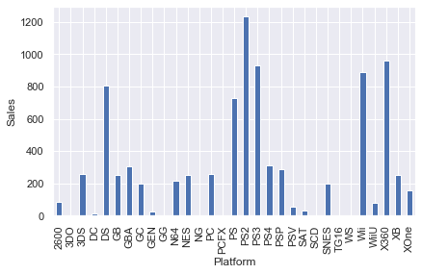
SALES BY PLATFORM
Video game historically have been spread out across the various consoles. With most of the success being concentrated with Nintendo, PlayStation, and Xbox

Slide 6
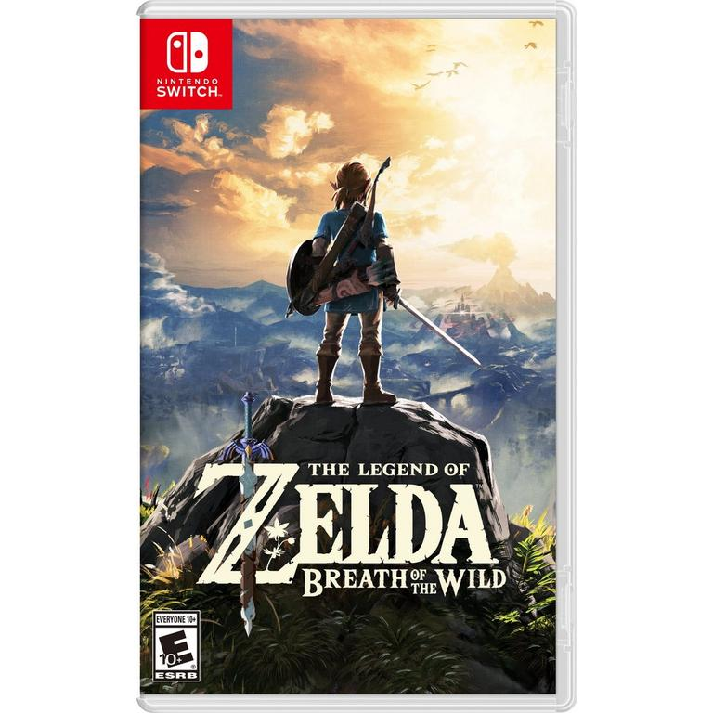
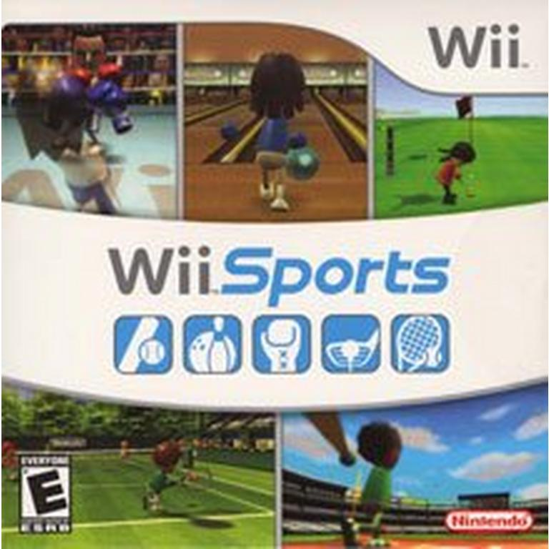
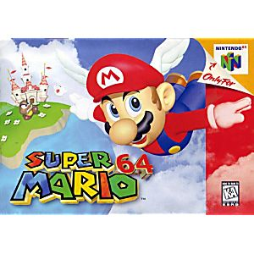
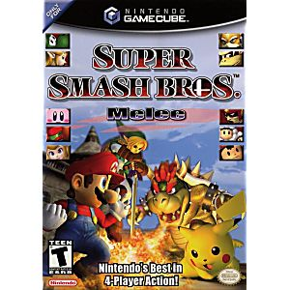
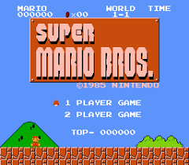
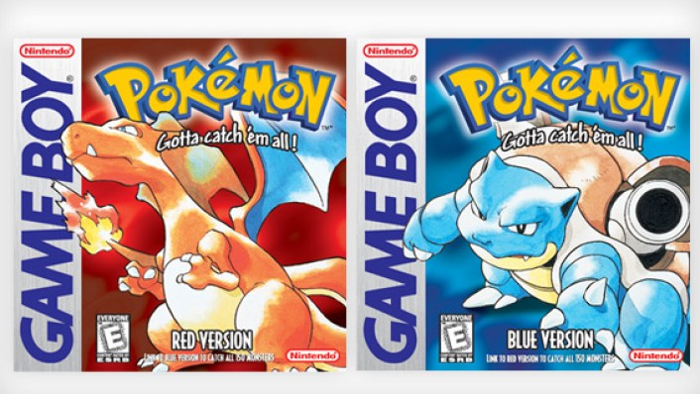
SALES BY PLATFORM
BEST SELLING GAMES FOR NINTENDO CONSOLES

Slide 7

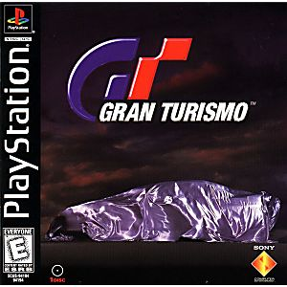
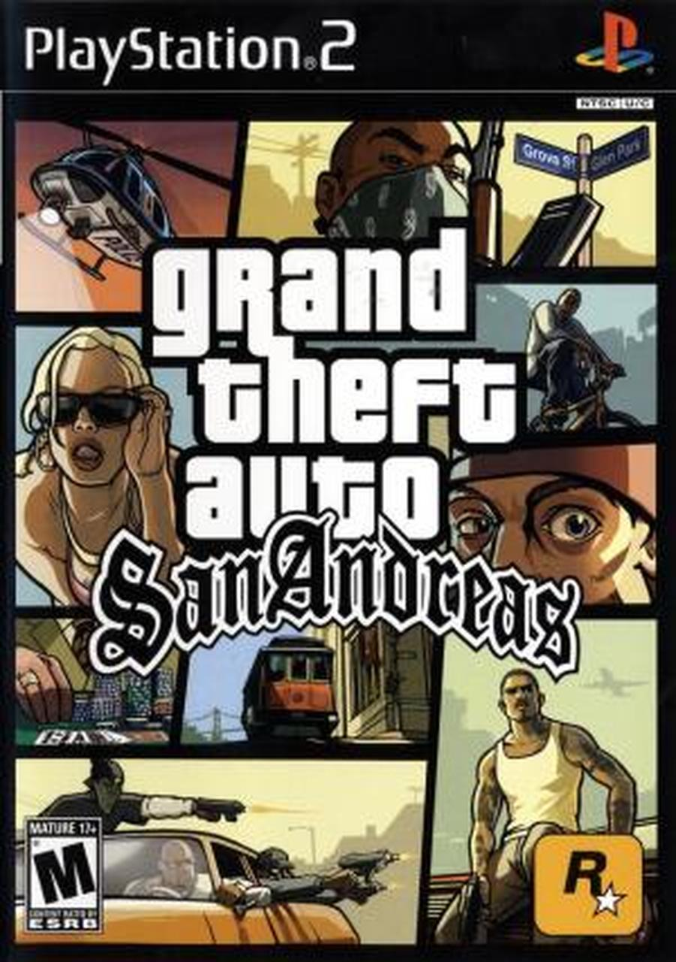
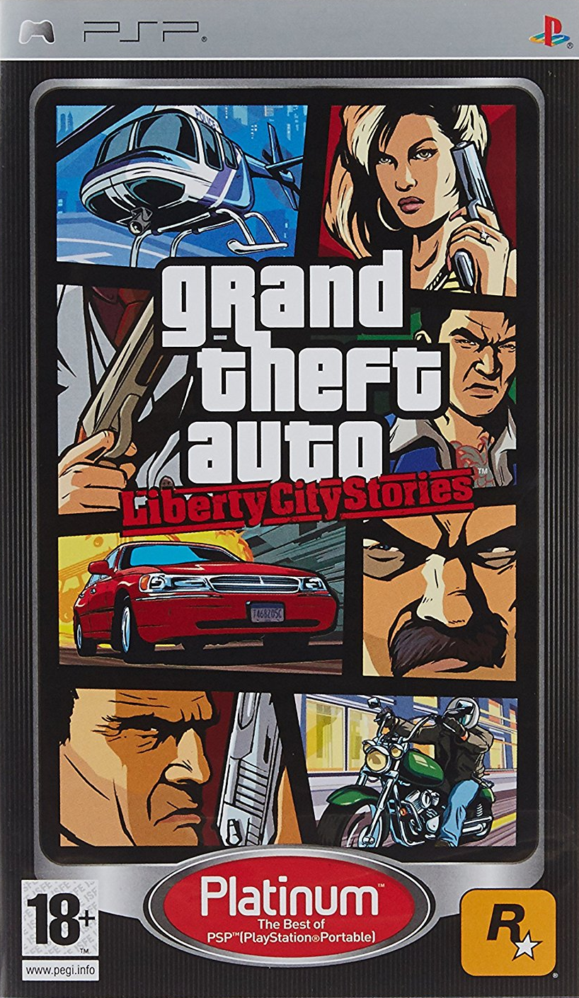
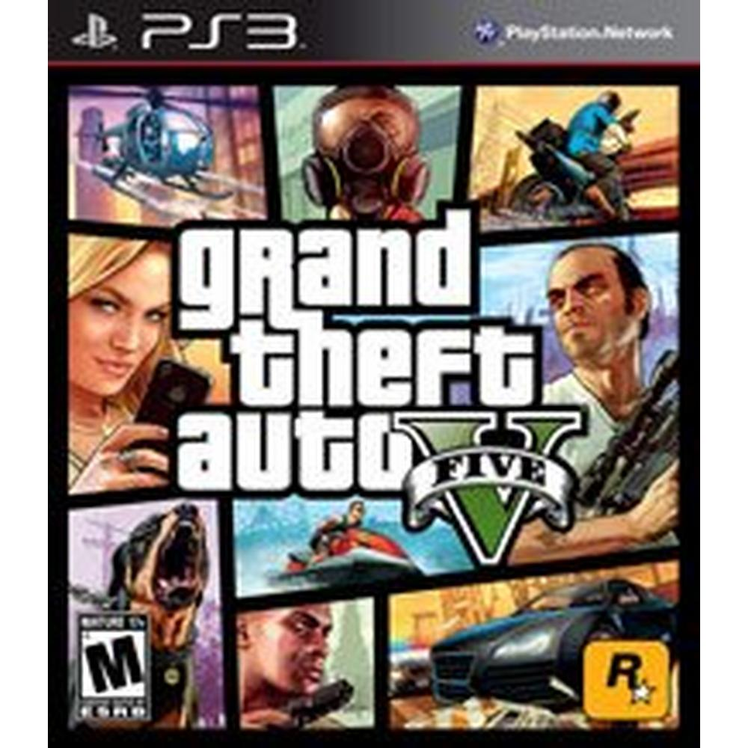
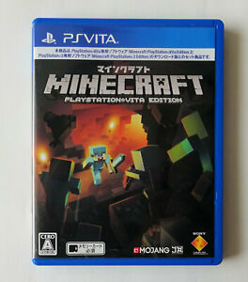
SALES BY PLATFORM
BEST SELLING GAMES FOR PLAYSTATION CONSOLES

Slide 8
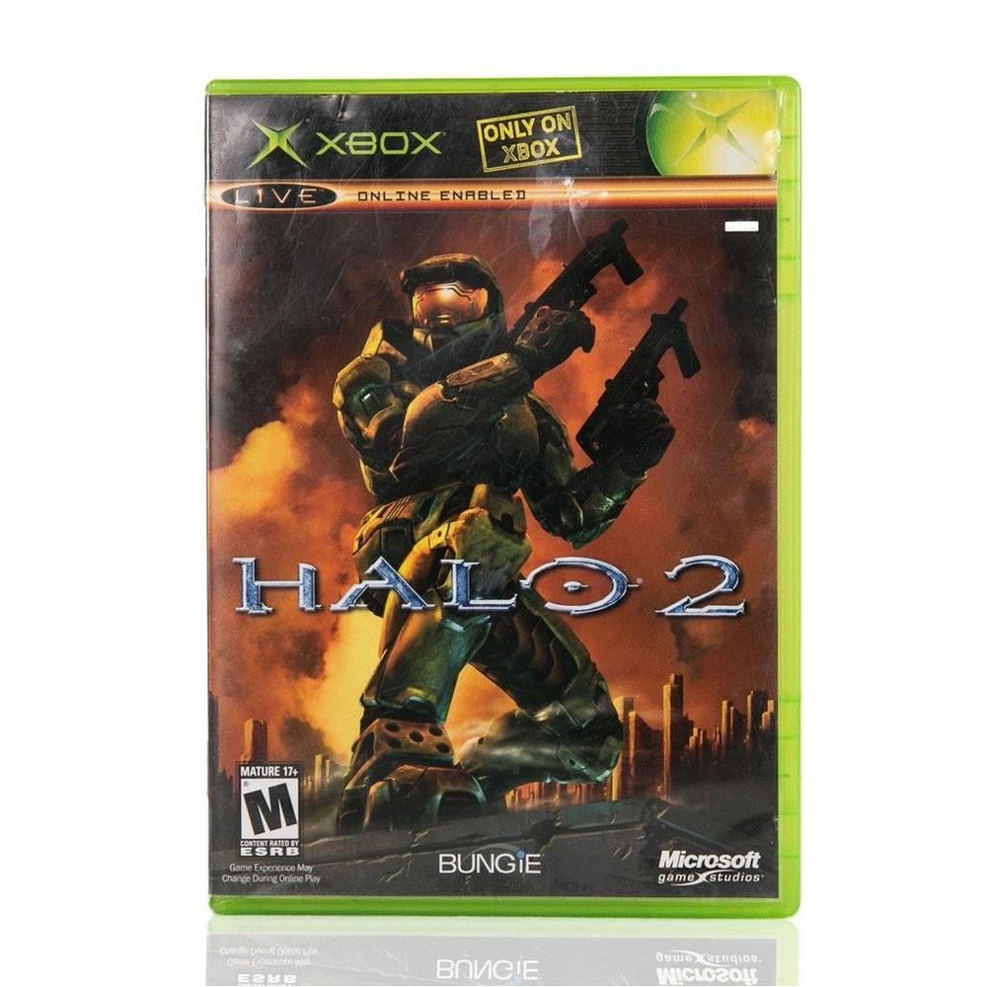

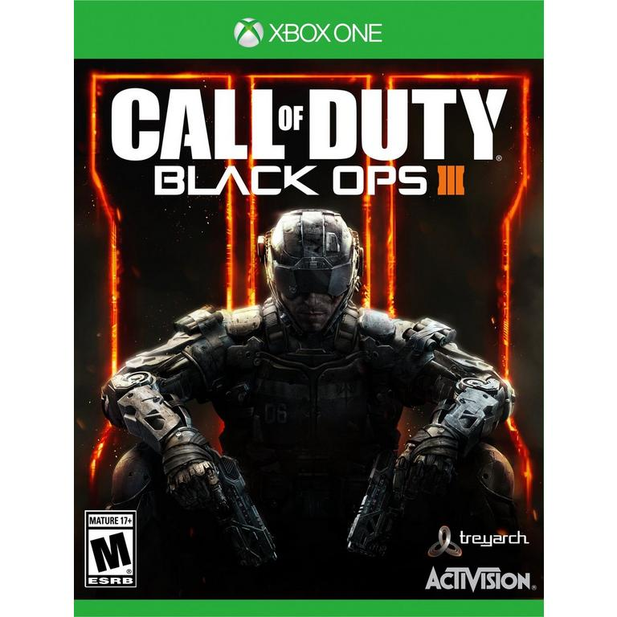
SALES BY PLATFORM
BEST SELLING GAMES FOR XBOX CONSOLES

Slide 9




Slide 10
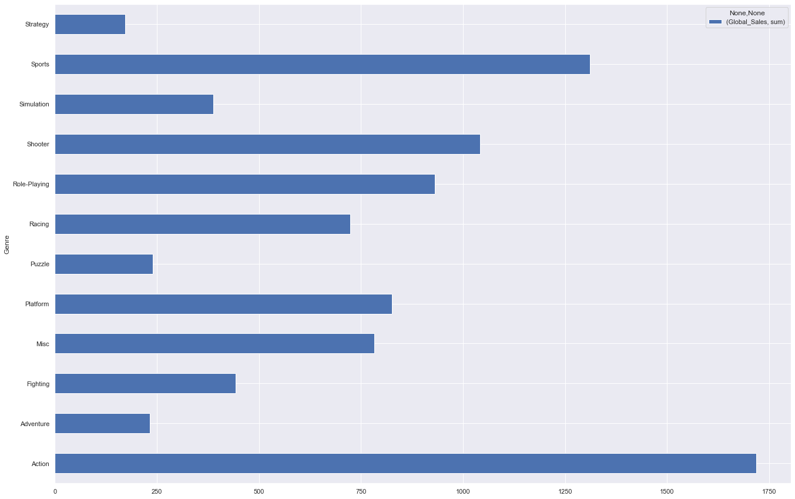
Historically Action games are the best-selling genre followed closely by sports

Slide 11
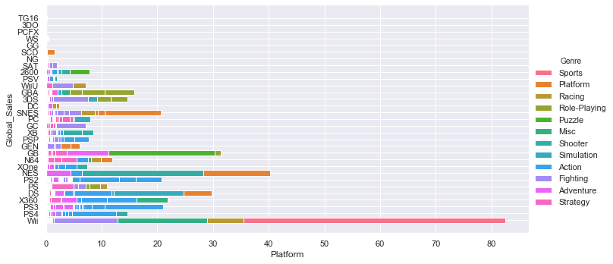
BEST SELLING GENRE BY CONSOLES

Slide 12
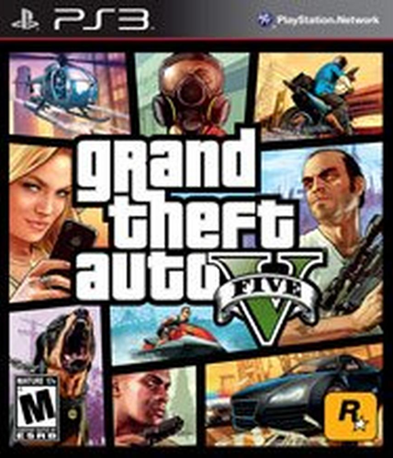
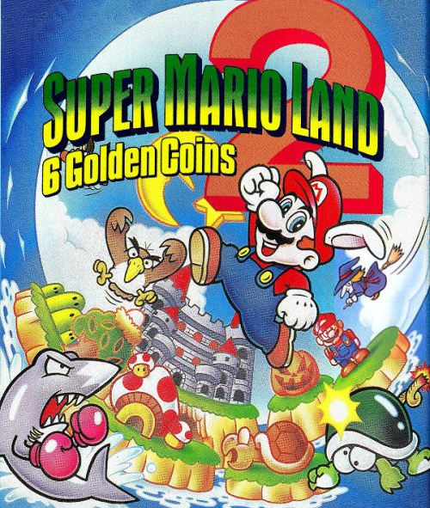
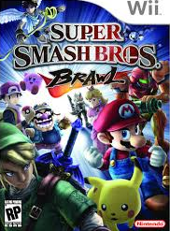
BEST SELLING GAME FOR EACH GENRE
ACTION
ADVENTURE
FIGHTING

Slide 13
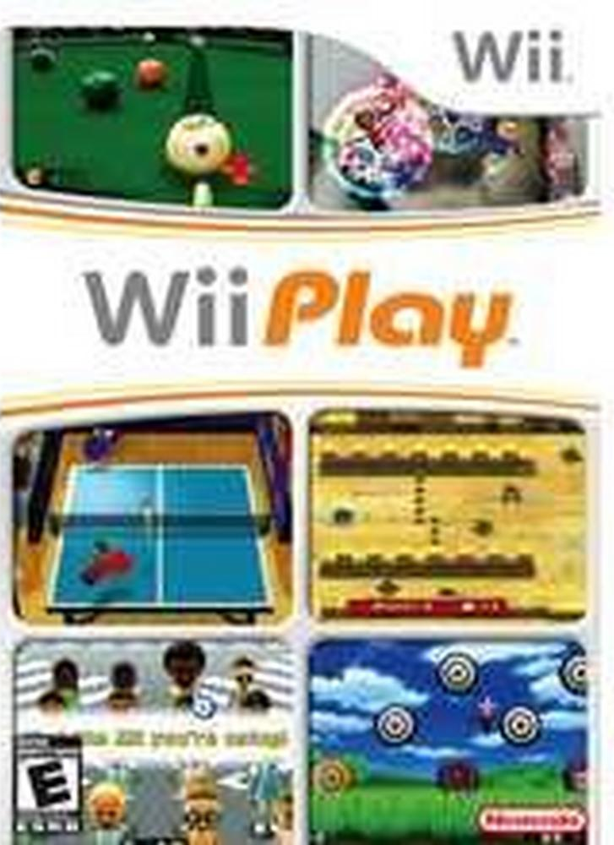

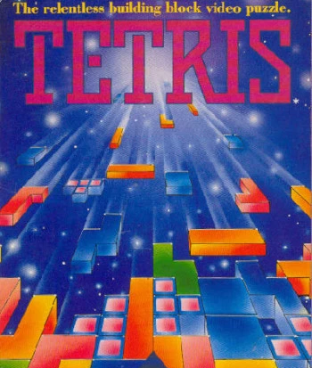
BEST SELLING GAME FOR EACH GENRE
MISC
PLATFORM
PUZZLE

Slide 14
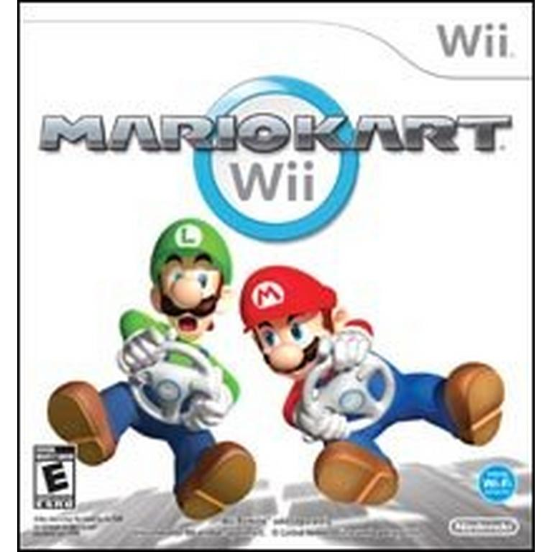

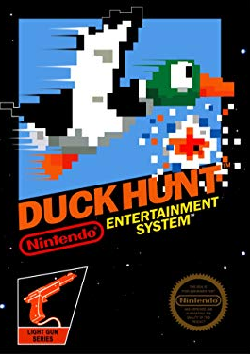
BEST SELLING GAME FOR EACH GENRE
RACING
ROLE-PLAYING
SHOOTER

Slide 15
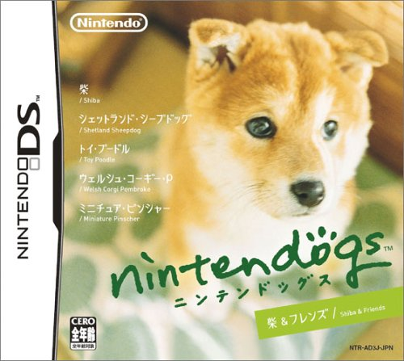

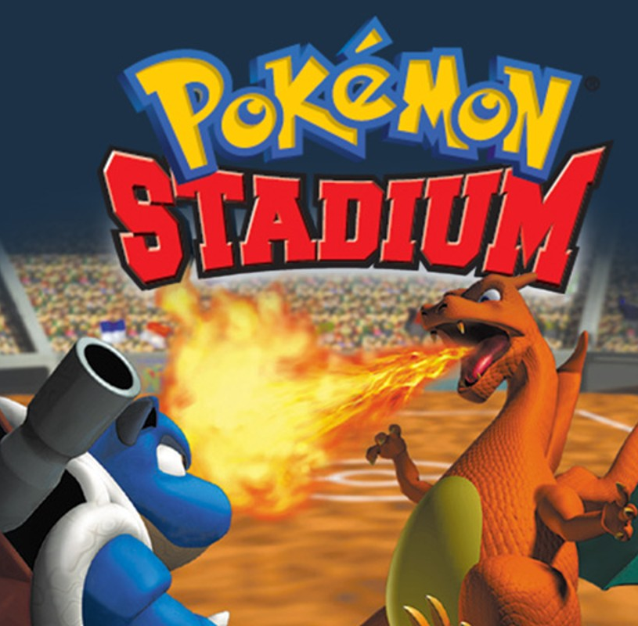
BEST SELLING GAME FOR EACH GENRE
SIMULATION
SPORTS
STRATEGY

Slide 16
DATA SET SUMMARY
Over the 40 years of data in this set the historical trend of the console industry are clear. Nintendo has the clear game sales lead because long history and 10 consoles.
An action game is the best-selling console game. However nine of the 12 best selling game are exclusive to Nintendo.
The next 40 years of console gaming will be interesting to see if Nintendo will be overtaken by PlayStation or Xbox.

